Slide 1
Inference based on simulations from the posterior distribution (using MCMC)

Slide 2
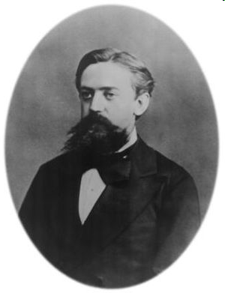
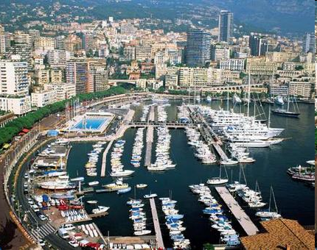
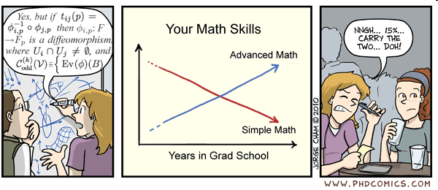
Etymology of MCMC
Monte Carlo:
a city in Europe famous for its Casino
Markov Chain:
a random process with the property that the probability next state depends only on the current state
+
=

Slide 3
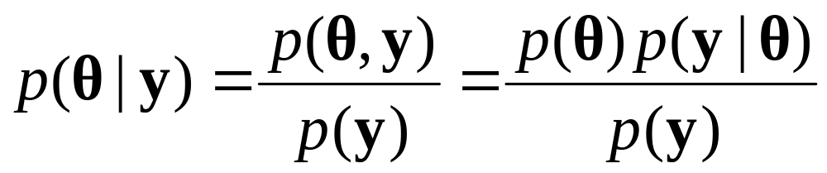
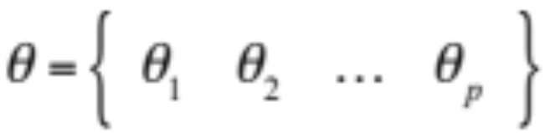
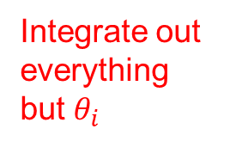
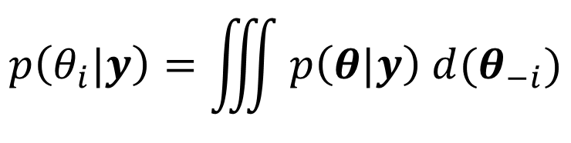
How is this used in Bayesian Inference?
Sometimes (virtually ALL the time), we have multi parameter models, this is θ is a vector. In such case, the joint posterior is easy to derive:
…
But: and we want to make marginal inferences on each component, this requires:
MCMC allows simulating from this distribution without actually integrating.

Slide 4
Some commonly used MCMC
The list is LONG with many being special cases of others or partially overlapping under certain assumptions.
Gibbs sampler
Metropolis-Hastings
Slice Sampler
Reversible Jump
Hamiltonian Monte Carlo
  No U Turn sampler (NUTS)

Slide 5
MCMC for Bayesian inference

Slide 6
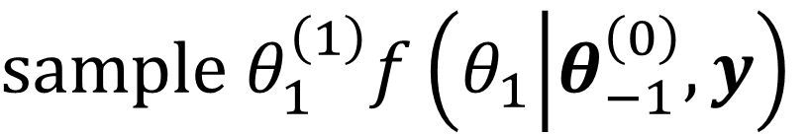
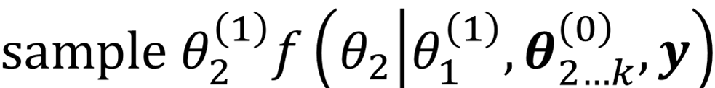
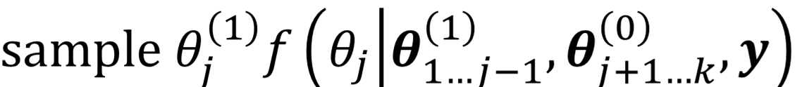
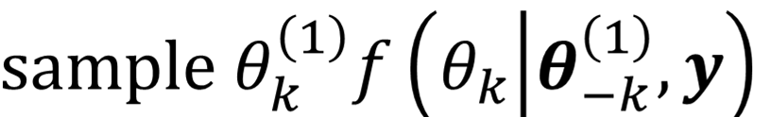
Alternative conditional sampler
$θ^{\left(0\right)}$
Give starting values to the vector of parameters:
Iteration number
$\begin{matrix} & & f\left(θ|y\right) \\ θ & = & \left\{θ_{1},θ_{2},...,θ_{j},...,θ_{k}\right\} \\ θ_{−j} & = & \left\{θ_{1},...,θ_{j−1},θ_{j+1},...,θ_{k}\right\} \\ & & f\left(θ_{j}|θ_{−j},y\right)\end{matrix}$
$θ^{\left(R+1...N\right)}$
Repeat N times to obtain a chain: discard R iterations:

Slide 7
MCMC and initial values
Notice that the implementation of the MCMC sample depends on the initial values.
Also notice that there will likely be autocorrelation.
If autocorrelation decreases monotonically, the state of the MCMC sampler will eventually be practically independent of the initial value

Slide 8
MCMC inference
The sampling algorithm has stationary distribution equal to the target distribution. So given a chain that starts from an arbitrary value:
(1) (N)
How to draw inferences?
(1) (R) (N)
Burn-in/warm-up:
How many to discard
(eliminate effect of
Initial values)
MCMC sample:
How many and which (do you need to thin out) to keep in order to provide a good representation of the target?

Slide 9
MCMC inference
This:
Or this?
Same number of “usable” iterations:
Lots of “waste”: accumulated burn-in
At first sight a single, long chain is “more efficient”

Slide 10
Not so fast!
This in one cpu (core):
Or this?
One in a different cpu?
Single long chain results in less total cpu time, but...
  Many short chains result in less real time!
Single long chain will result in smaller (effective) sample size
  Many short chains are independent and allow better diagnostic criteria
Assess which one is better given available resources

Slide 11
Monitoring convergence
Many procedures, implemented in R packages (coda, rstan, bayesplot, shinystan)
We will go over them quickly
There is a review in angel site
As you use these methods you'll develop a good sense of when to use which one
Inspection of plots is NOT A GOOD way of determining convergence or sample size!

Slide 12
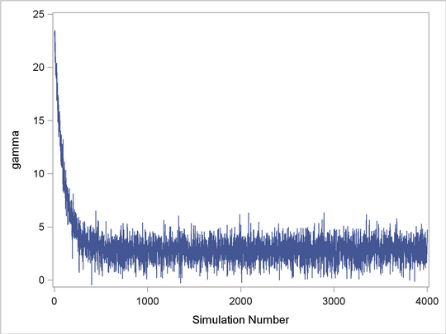
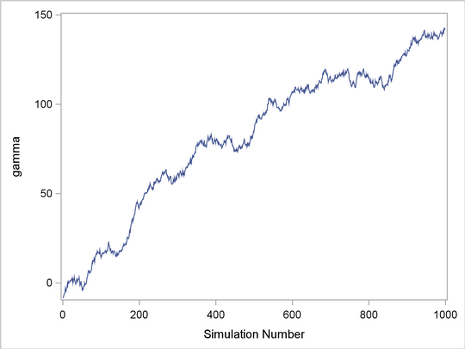
Trace Plots
Converged?
Drifting… clearly not converged
Theta
Theta
Iteration number
Iteration number
Visual inspection is usually not conclusive

Slide 13
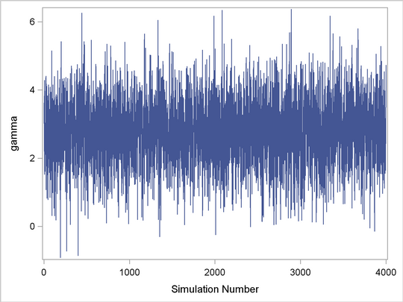
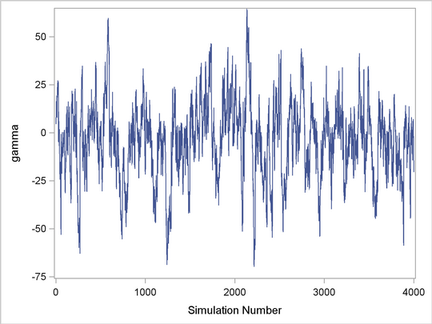
Trace Plots
Seemingly stable with poor mixing
Theta
Theta
Iteration number
Iteration number
Notes:
LEFT: Note that the center of the chain appears to be around the value 3, with very small fluctuations. This indicates that the chain could have reached the right distribution. The chain is mixing well; it is exploring the distribution by traversing to areas where its density is very low.
RIGHT:The chain is taking only small steps and does not traverse its distribution quickly. This type of trace plot is typically associated with high autocorrelation among the samples. To obtain a few thousand independent samples, you need to run the chain for much longer.
Copyright Nora M. Bello - STAT 950 - Spring 2012 - Kansas State University

Slide 14
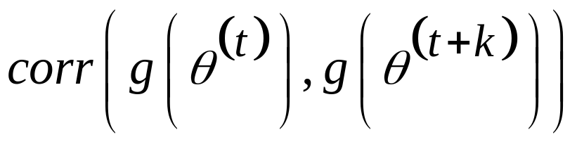
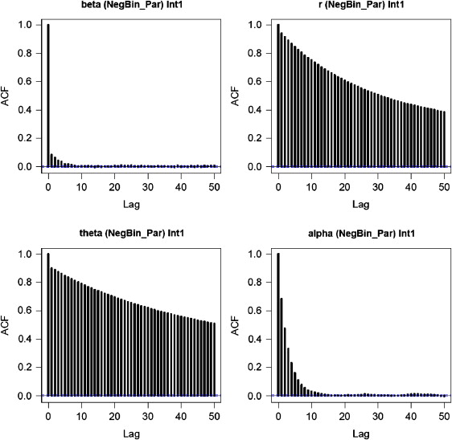


Autocorrelation Plots
t is iteration #, k is lag
Warning: if burn-in is not discarded, autocorrelation is inflated
Notes:
Copyright Nora M. Bello - STAT 950 - Spring 2012 - Kansas State University

Slide 15
Thinning out?
This running on one processor, but effective sample size is one tenth:
Or should I keep just one every ten iterations that are almost uncorrelated?
Most books and papers will tell you that “if there are no memory limitations”, it is always better to keep all samples.
That is a HUGE IF.
Saving to disk? Time starts being a concern.
Right answer?
I can't give it to you: check your system (hardware and software), benchmark it, spend time planning the run rather than jumping heads first into a 10 Billion sample algorithm!

Slide 16
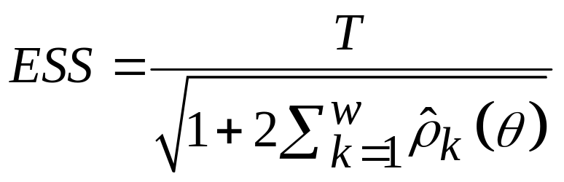
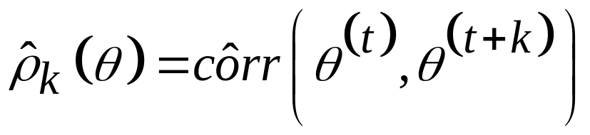
Effective Sample Size
Effective number of independent simulation draws
Sample size adjusted for autocorrelation
For w sufficiently large so that autocorr is small… <0.1?
T is the number of simulation draws (or MCMC iterations)
is the estimated autocorrelation of lag k
Kass et al. 1998

Slide 17
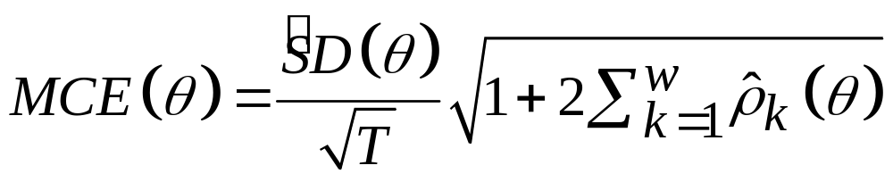
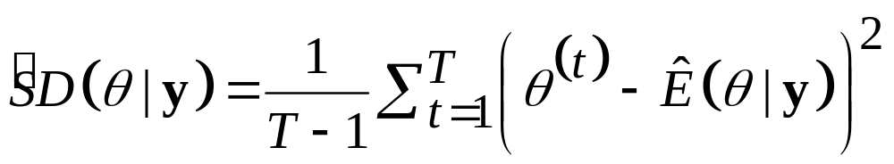
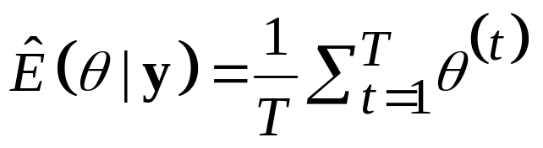
Monte Carlo Error
Variability of each estimate due to simulation
Inversely proportional to the generated sample size controlled by the user
where
Roberts 1996

Slide 18
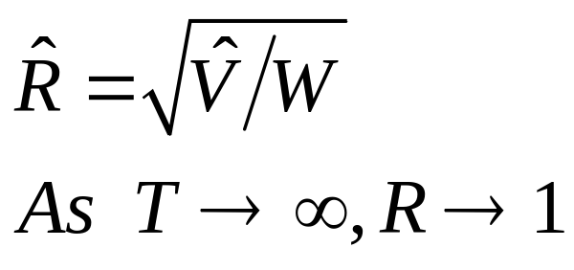
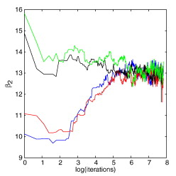
Gelman and Rubin method
Multiple chains from over dispersed initial values
Compute this for each parameter of interest
Within chain variance:
Total variance
F-like statistic in an ANOVA

Slide 19
Caveats
Over dispersed initial values are needed
In multi-parameter inference, lots of graphical output
It will “behave” better for Gaussianly distributed parameters (transform if needed)
If all parameters are of interest, monitor the log-posterior density value (it may require additional computation)

Slide 20
Geweke's criteria
Use single, long chain (n after burn in) and divide it in two subchains:
Burn in: Discard
Sub chain 1: f₁n
Do not use: f₂n
Sub chain 2: f₃n
Perform a t-test between the two sub chains, if reject, add another subchain and keep testing.
Default values for CODA: f₁=0.1, f₃n=0.3

Slide 21
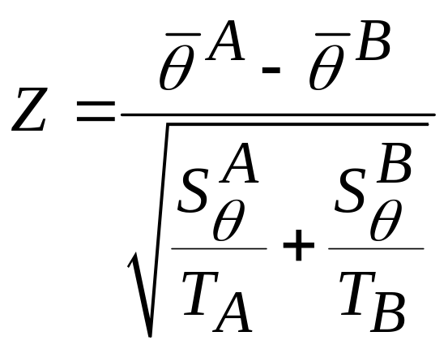
Geweke’s Criteria
Simple z-test to check whether the means estimated from the beginning and end of the MCMC chain are equal
A may be initial 10% and B may be the last 50% of total iterations… other combinations?
If many parameters, allow ~5% of calculated Z’s to lie outside of [2,-2]
Geweke 1992
Notes:
C = # chains
T = chain length, number of iterations
Copyright Nora M. Bello - STAT 950 - Spring 2012 - Kansas State University

Slide 22
Overall strategy
Run several short chains
  Use Gelman and Rubin
Or run a long chain
  Confirm convergence using Geweke’s
  Look into ESS, MCSE
Or use a combination of the above

Slide 23
Do and Don't
Do run multiple diagnostic criteria
Do check convergence of EVERY run
Do use visual diagnostics as a help to objective diagnostics
Do try to improve the sampling

Slide 24
Do and Don't
Do not use default sample sizes blindly
  Do not use the sample size a colleague used in a previous paper and be happy with it
  Do not use the sample size you came up with 3 semesters ago with a “similar” dataset ☺
Do not use visual diagnostics ONLY
Do not prescind of visual diagnostics

